Slide 1
Image Generation using Variational Autoencoders (VAE)
Submitted By –
- Aarat satsangi
- B.Tech. 4th Year Electrical (CS)

Slide 2
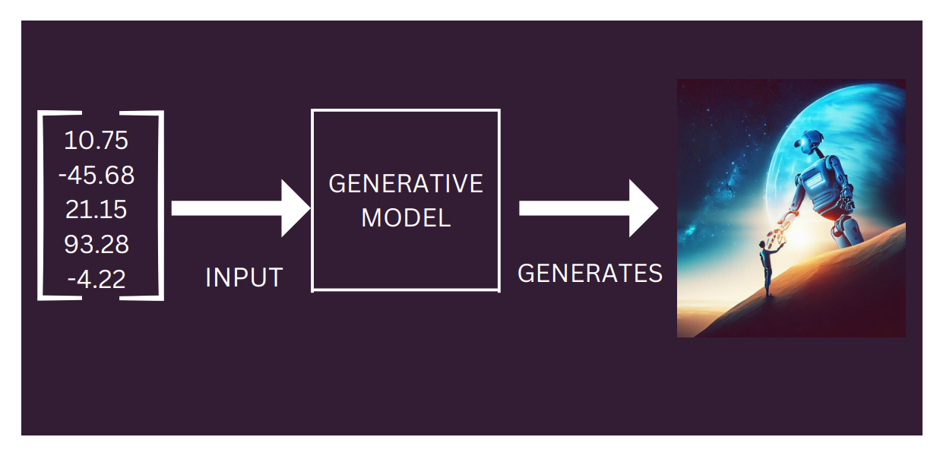
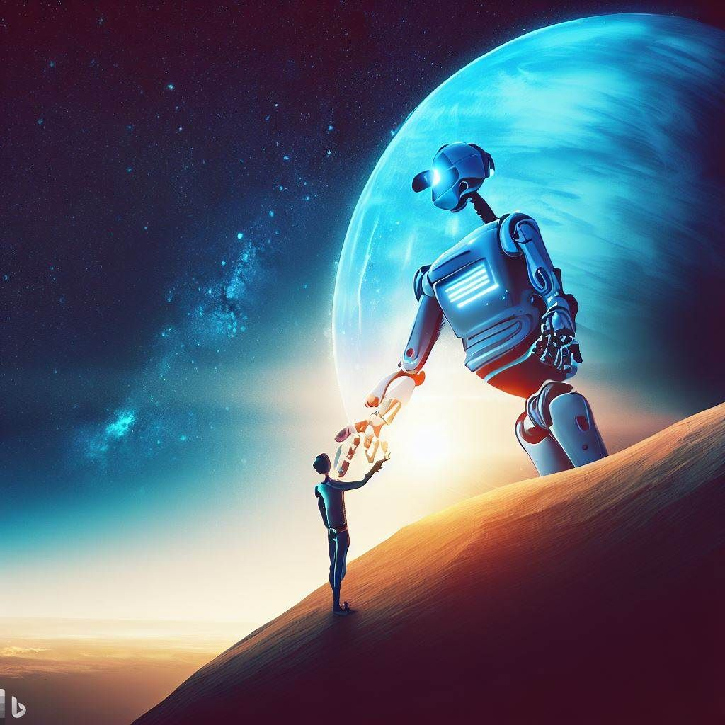
What are Generative Models ?
It’s just a Neural Network that is able to Generate a similar kind of data that it has been trained on.
Some Types of Generative Models are –
Generative Adversarial Networks (GAN)
Restricted Boltzmann Machine
Deep Belief Network
Variational Autoencoder (VAE)

Slide 3
Autoencoder - A Brief Introduction
The word ‘Autoencoder’ is made up of two words –
Auto – Encoder
What are Encoders?
Examples in day to day activities –
When you talk on your phones, your voice gets converted from vibrating waves to electronic 1s and 0s and encoded before being sent over the communication channel by various encoding schemes like PCM, DM, ADM (Analog to Digital), ASK, FSK, PSK(Digital to Analog) etc.
When you capture an image from a DSLR camera, it gets saved in RAW format, which although preserves all the information in a photo, but takes up a lot of storage. To store photos we use compression methods to encode the images to obtain a more compact size. For example – JPEG, GIF, BITMAP, PNG etc.
Examples in the field of Machine Learning –
Principal Component Analysis (PCA), Independent Component Analysis (ICA) for Dimensionality Reduction.

Slide 4
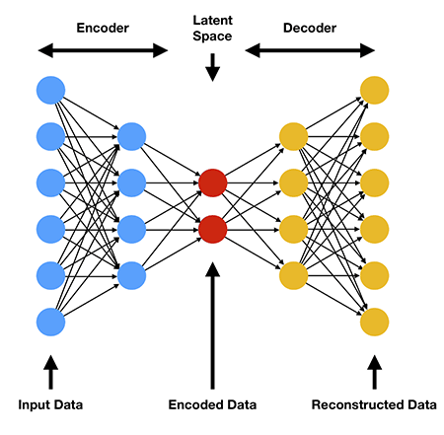
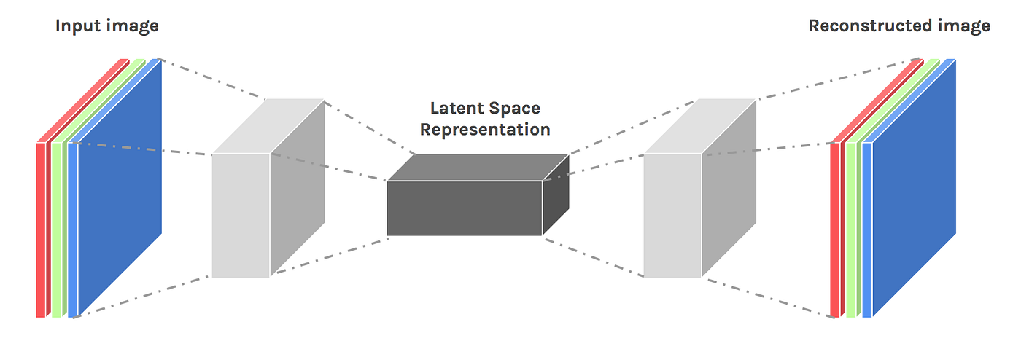
Autoencoder - A Brief Introduction
So, What does the Architecture look like –
Convolutional Autoencoder Architecture
Autoencoder Architecture

Slide 5
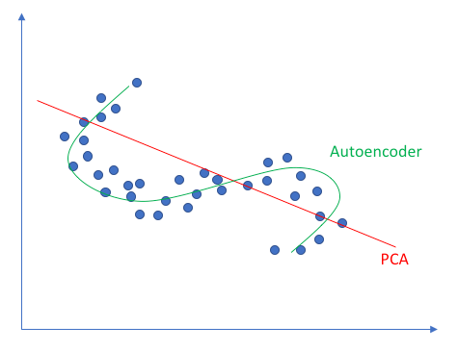
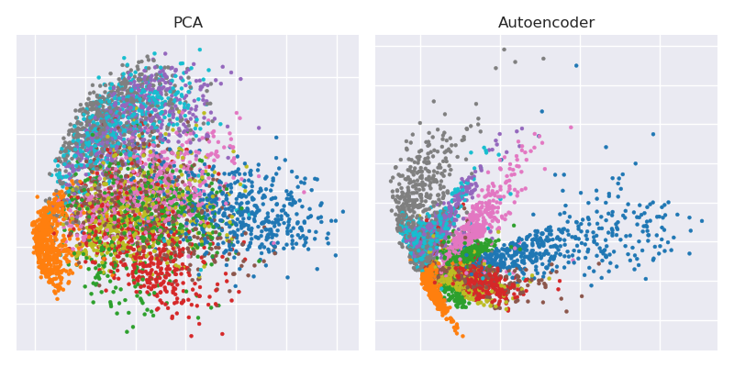
Autoencoder - A Brief Introduction
PCA Vs AE
PCA Vs AE
(MNIST)

Slide 6

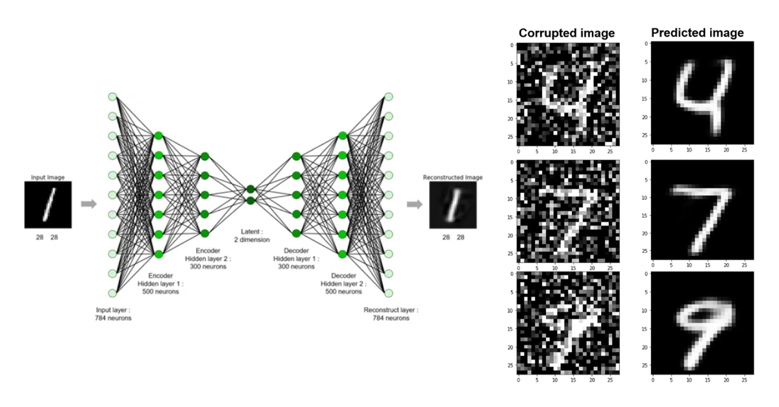
Autoencoder – Uses
Dimensionality Reduction
Image Compression
Image Denoising
Image generation
Sequence to sequence prediction

Slide 7
Autoencoder – Problems!!
The latent space plot isn’t symmetrical around the origin
Some labels are represented over small areas, others over large ones
There are discontinuities in the latent space

Slide 8
Towards Variational Autoencoders
To solve these problems associated with vanilla Autoencoders, we have to modify a 2 things –
Modify Encoder component
Modify loss function
Vanilla Autoencoder
Question: What loss function would you use for a vanilla Autoencoder?

Slide 9
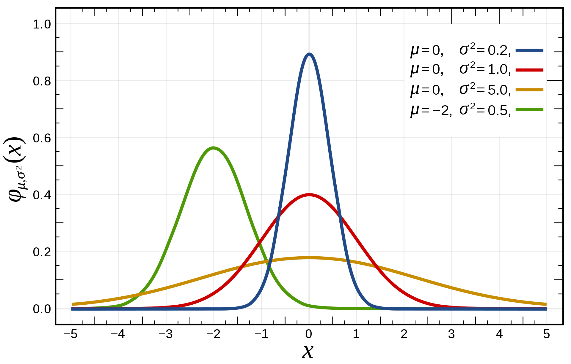
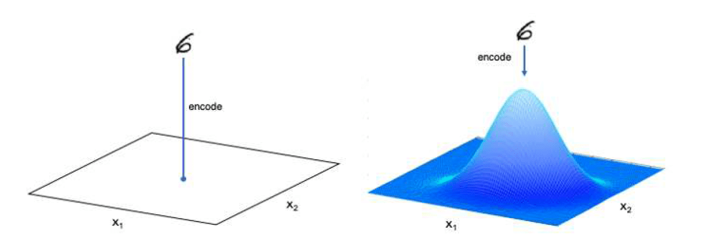
VAE – Modifying Encoder
The Encoder was mapping the input data to just one point in the latent space.
What if, instead of mapping it to a point, we map it to a distribution in the latent space?
But which distribution?
Multivariate Normal (Gaussian)Distribution!!
We will need µ and σ
Encoder Mapping: AE vs VAE

Slide 10
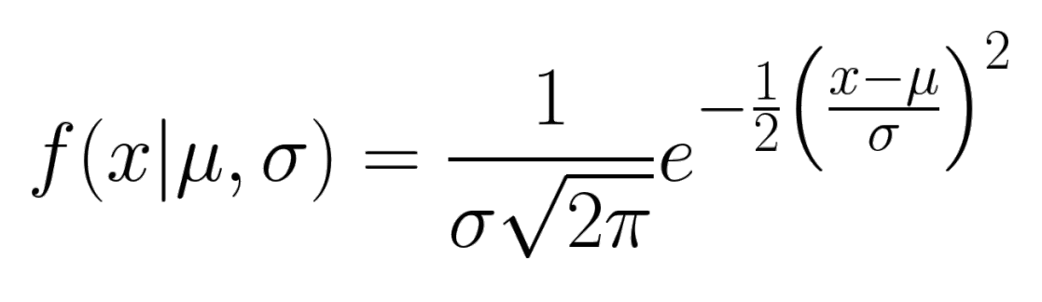
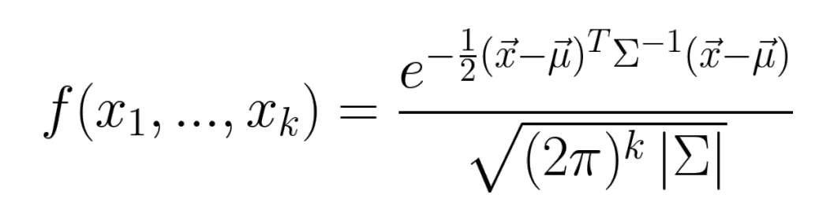
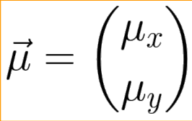
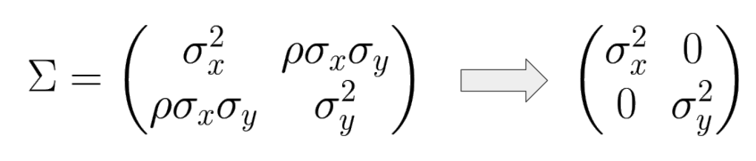
VAE – Modifying Encoder
Gaussian Distribution: 1D
Multivariate Gaussian Distribution
In 2d, µ and σ would be in the form -
VAE assumes that there is no correlation between dimensions, i.e. ⍴ = 0.

Slide 11
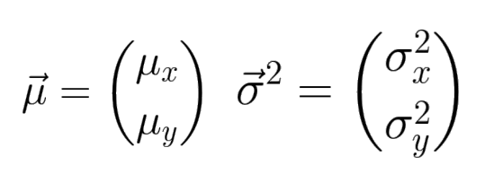
VAE – Modifying Encoder
The encoder in VAE leverages the attributes of Multivariate Gaussian Distribution and maps each input to a mean vector and a variance vector in the latent space

Slide 12
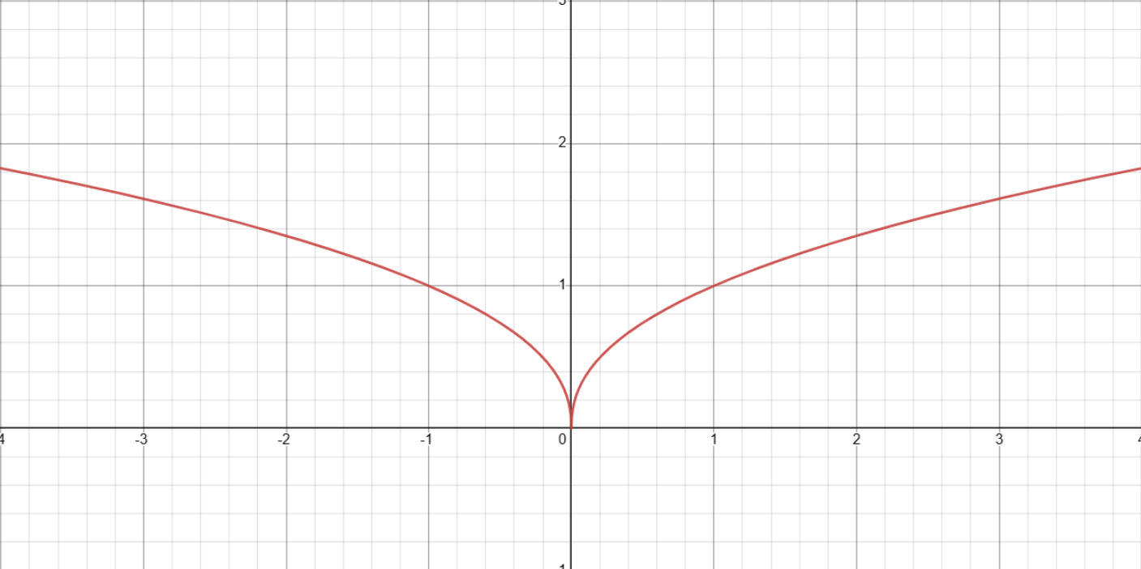
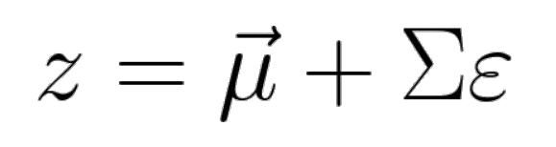
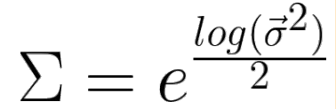
VAE – Modifying Encoder
Now that we have mapped the input to a Multivariate Gaussian Distribution, we need to take a sample from it, which will be our point in the latent space representing the input.
To take the sample we do –
Graph of Σ
Sampled Point
from
Standard Normal Distribution
Question: But why do we use Σ as exponential to the power of logarithm?

Slide 13
VAE – Modifying Encoder
So, what have we achieved so far?
We’re sampling a random point around the mean value for encoding.
Which basically says that the points in the same area produce very similar images when decoded
VAE ensures a quasi-continuous latent space
That means - we can now sample any point in the latent space, expecting the decoder to create a well formed image.
Answer: It brings stability and ease of training. By definition sigma has to be a positive real number. one way to enforce this would be to use a ReLU funtion to obtain its value, but the gradient is not well defined around zero. In addition, the standard deviation values are usually very small 1>>sigma>0. The optimization has to work with very small numbers, where the floating point arithmetic and the poorly defined gradient bring numerical instabilities.

Slide 14
VAE – Modifying Loss
Previously we had –
Loss = RMSE
After Modification we have –
Loss = α * RMSE + KL-Divergence
Reconstruction Loss Weight
Reconstruction Error
Kullback–Leibler Divergence:
Reconstruction Loss Weight –
Finding the correct value for 𝜶 is a delicate exercise
If 𝜶 is too small -> poorly reconstructed images
If 𝜶 is too large -> same issues as with AE
𝜶 can be treated as a hyper-parameter to optimize

Slide 15
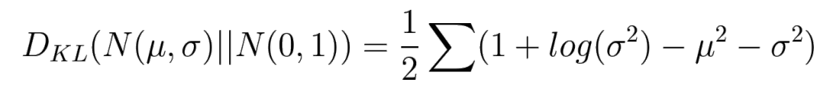
VAE – Modifying Loss: KL-Divergence
So, what is Kullback-Leibler Divergence?
It is a measure depicting how much the normal distribution (mean vector, log variance vector) made in the latent space differs from standard normal distribution.
Measures the difference between two probability distributions
It’s not a distance
KL divergence isn’t symmetric
KL(A, B) ≠ KL(B, A)
Can be given in “closed” form with normal distributions
Normal Distribution
Standard Normal Distribution

Slide 16
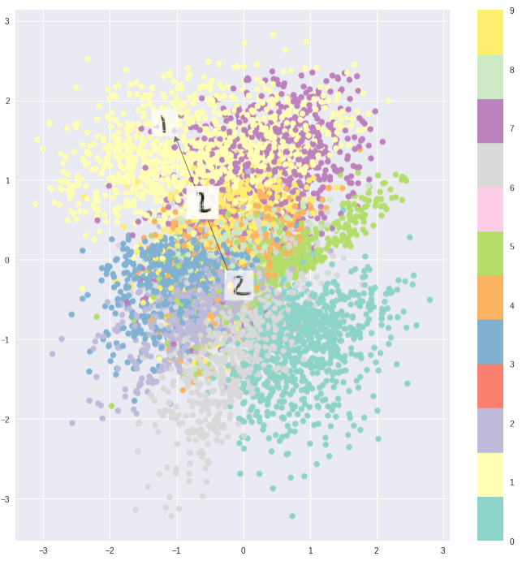
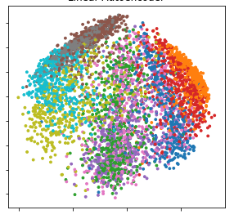
VAE – Modifying Loss: KL-Divergence
So what does KL divergence do?
Promotes symmetry around the origin
Decreases chance of large gaps between clusters of points
Autoencoder on MNIST
Variational Autoencoder on MNIST

Slide 17
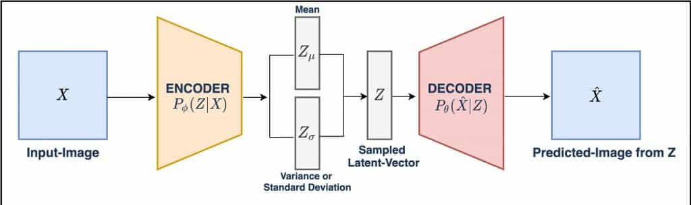
VAE – Architecture
Finally, the architecture of a Variational Autoencoder looks something like –
Reparametrizing Trick!
For Back Propagation.

Slide 18
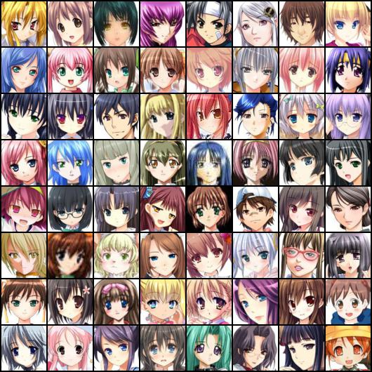
Anime Face generator using VAE
About Dataset – “Anime Face Dataset”
This dataset has 63,632 "high-quality" anime faces.
Link: Anime Face Dataset | Kaggle

Slide 19
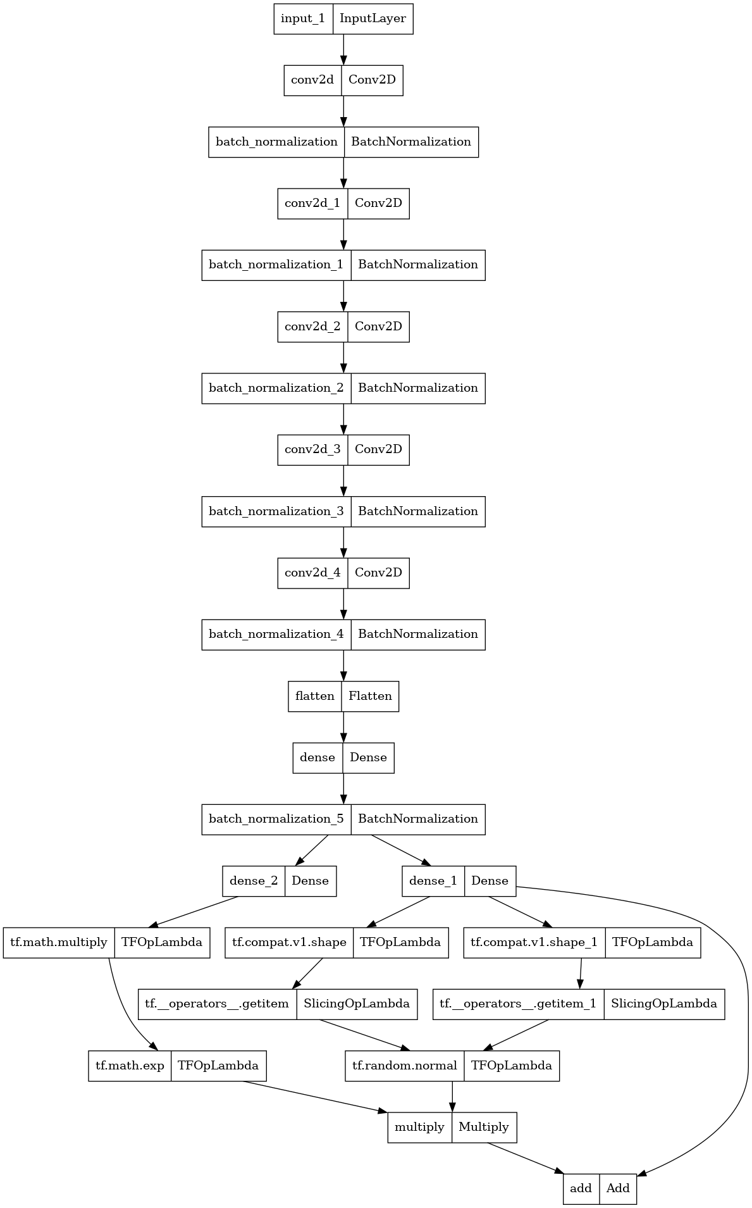
Anime Face generator using VAE
Encoder

Slide 20
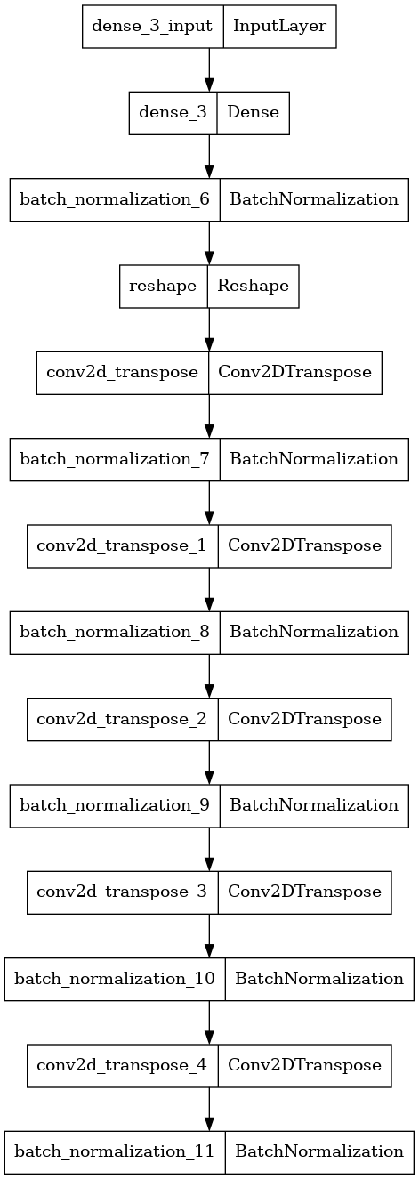
Anime Face generator using VAE
Decoder

Slide 21
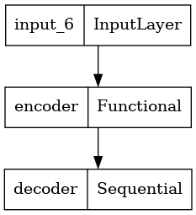
Anime Face generator using VAE
Variational Autoencoder
Project Link: Anime-Face-Generator VAE

Slide 22
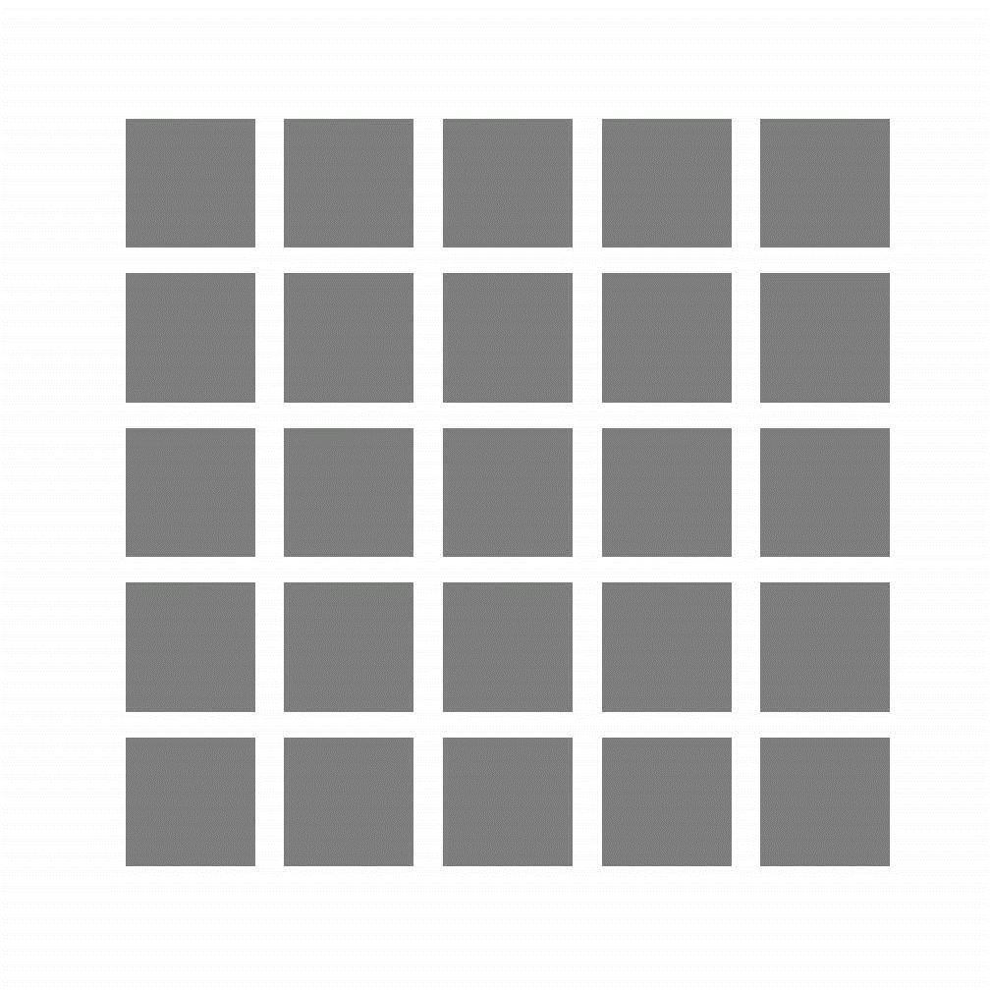
Results After Training

Slide 23
Thank You!

